Slide 1
Contact Manager

Slide 2



Meet the team
Jason Dhillon
Database
Brady Hill
API
Navneet
Murali
UI
Alejandro Zamora
UI

Slide 3
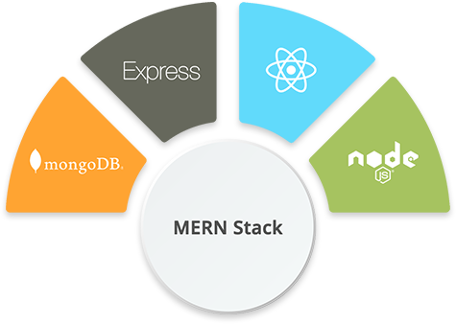
Meet the stack
Why?
NoSQL database
One team member had experience with this stack (Brady)
We all watched the same tutorial on Youtube
React is used by Facebook and Instagram

Slide 4
Meet the Gantt chart

Slide 5

ERD
Contacts
Users
User_id
First Name
Last Name
Address
Phone Number
Email
FK
Id
Username
Password
PK

Slide 6
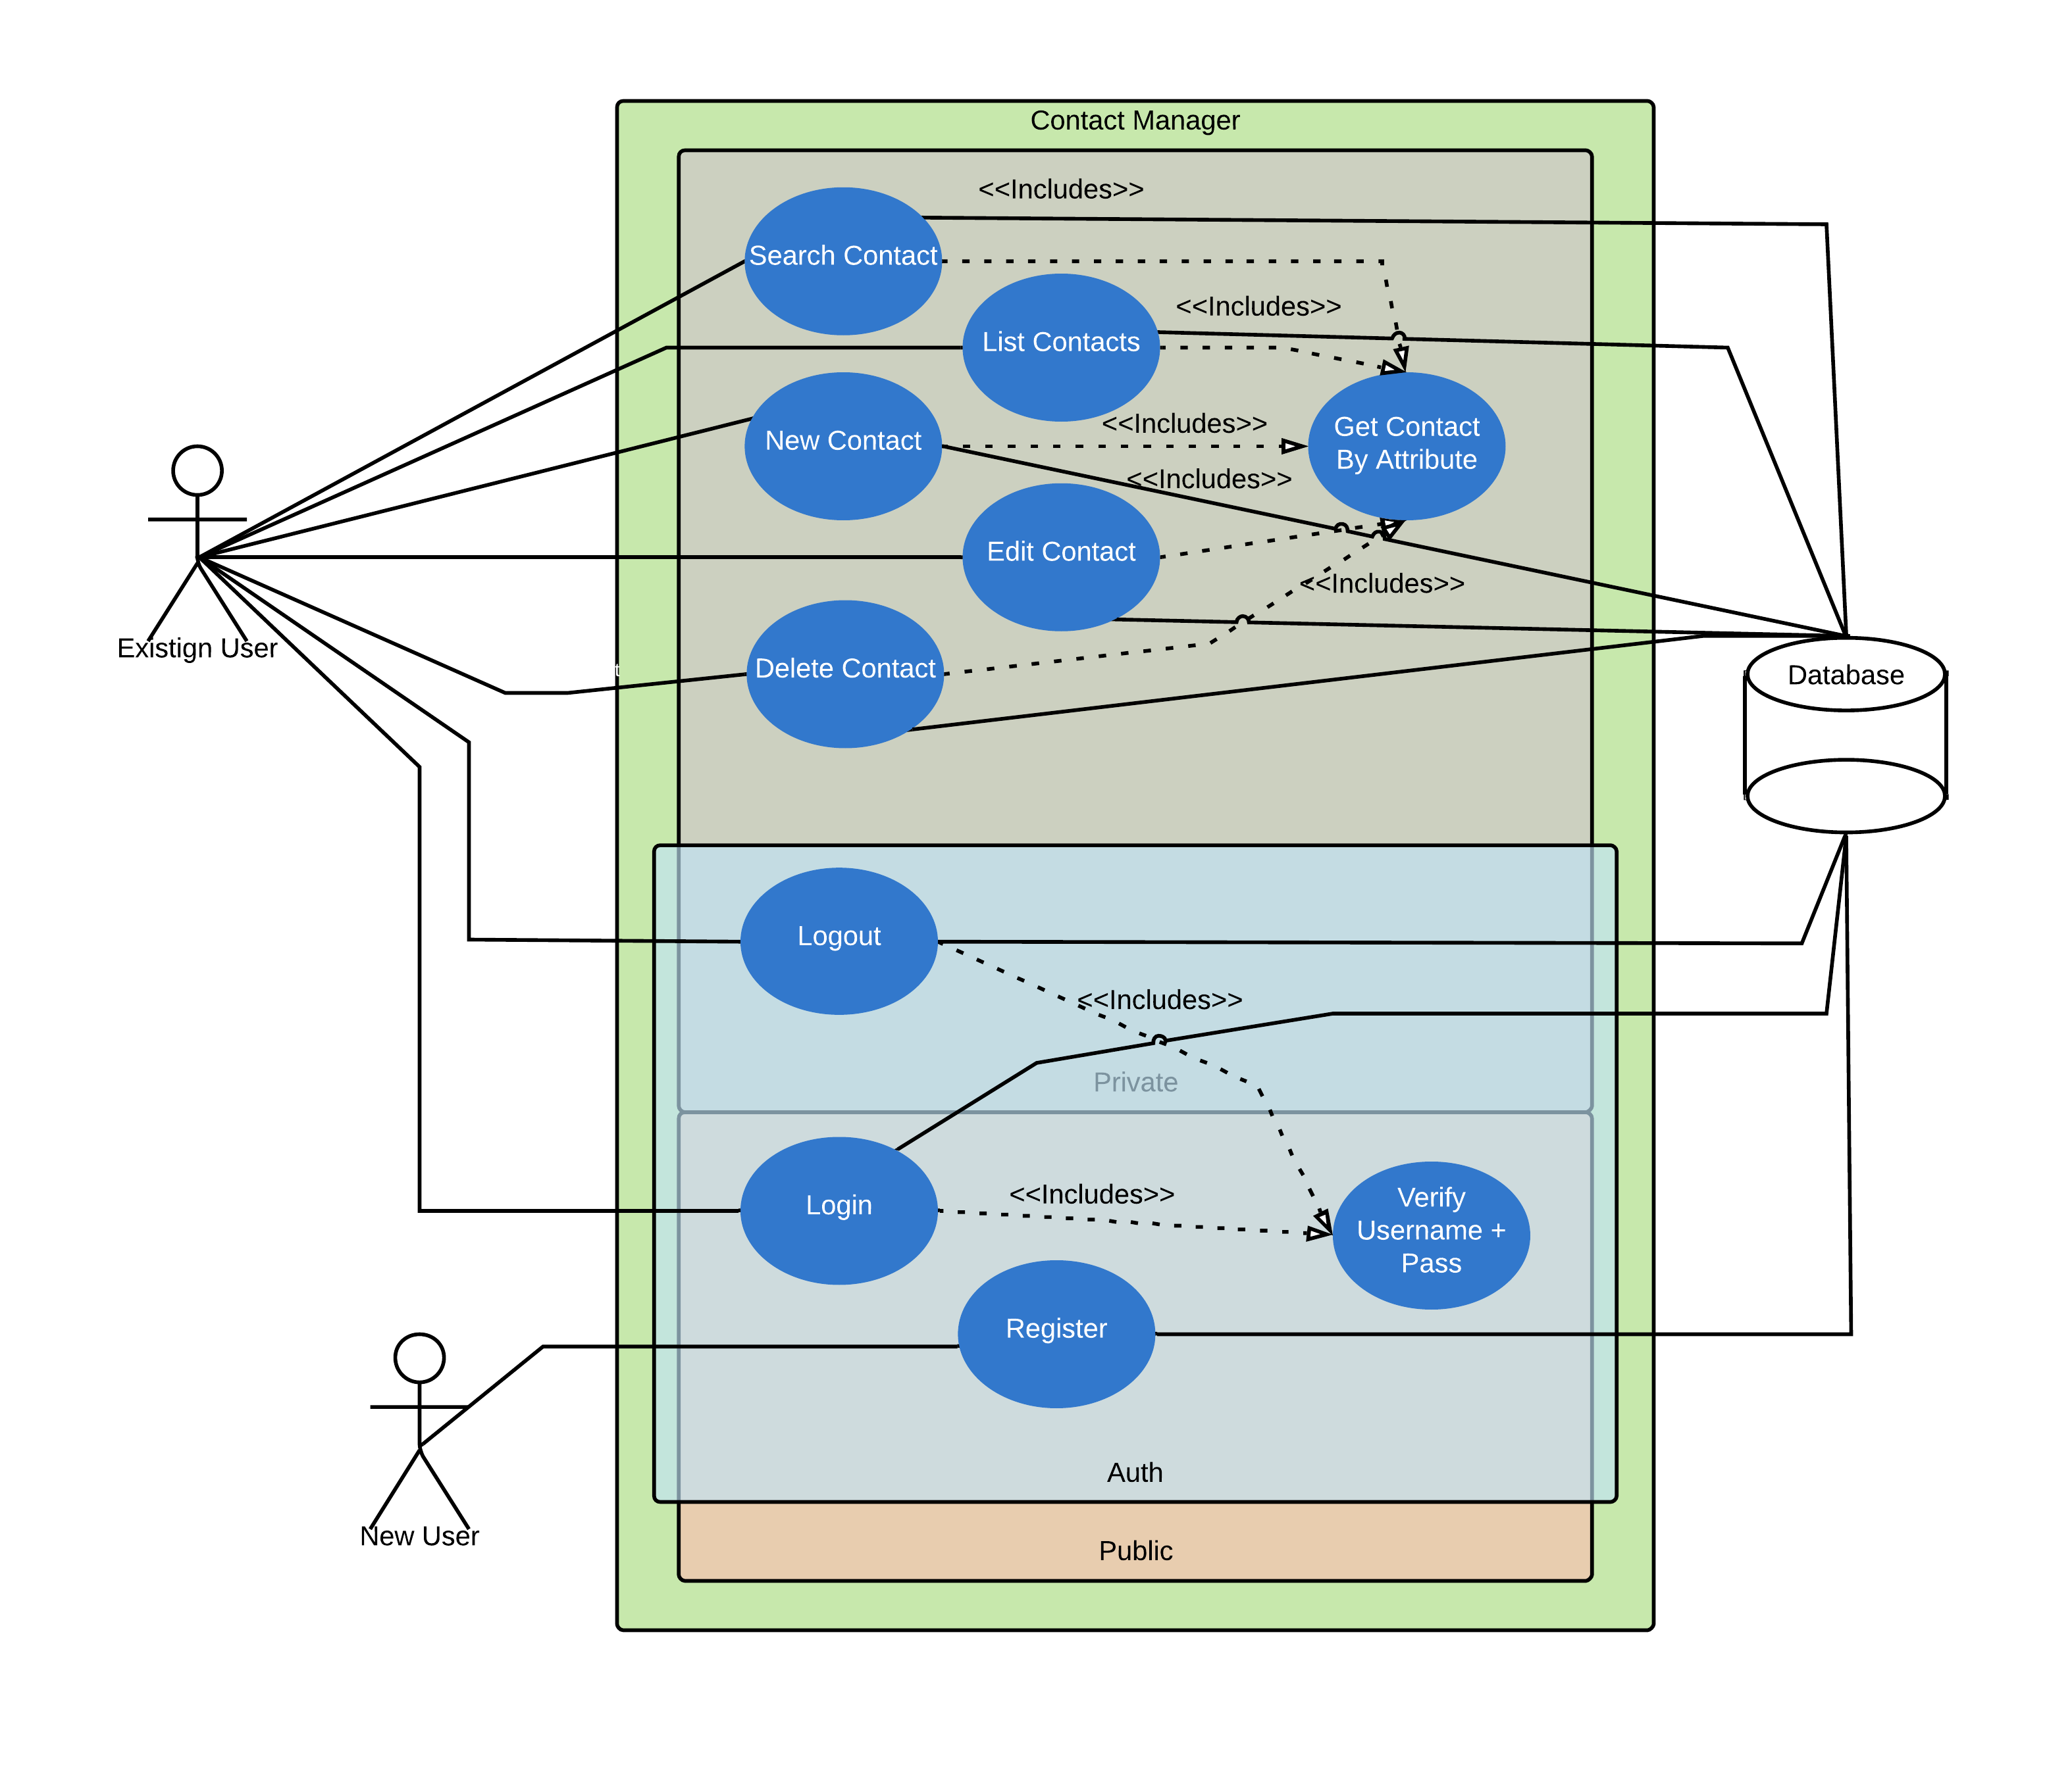
UML
Existing User

Slide 7

Things that went well
Dorian (Hurricane)
Jason MVP
Trello
Going last
Watching others fail

Slide 8

Things that didn't
MERN has a learning curve
Hard to meet up
Project was left alone until people started presenting
Alejandro hates web development

Slide 9

DEMO
CONTACT MANAGER

Slide 10

Questions?

